Slide 1
JavaScript Tutorials
From basic to advanced
By- Gautam Kumar (uidhtml.com)

Slide 2
JavaScript Chapter -1
Topics
What is JavaScript
History
Client-side
Server Side
Advantages of JavaScript
Limitations of JavaScript
Imperative vs Declarative JavaScript
JavaScript Development tools
JavaScript at the current time
JavaScript Tutorials
Gautam Kumar- uidhtml.com

Slide 3
What is JavaScript
JavaScript Tutorials
Topics
What is JavaScript
History
Client-side
Server Side
Advantages of JavaScript
Limitations of JavaScript
Imperative vs Declarative JavaScript
JavaScript Development tools
JavaScript at the current time
Interpreted programming language, with object-oriented capabilities.
Lightweight
Mostly used for web pages, where it allows the client-side to interact with the user.
It’s a single-threaded programming language.
Used for client-side and server-side development.
It’s a dynamic programming language too.

Slide 4
History of JavaScript
JavaScript Tutorials
Topics
What is JavaScript
History
Client-side
Server Side
Advantages of JavaScript
Limitations of JavaScript
Imperative vs Declarative JavaScript
JavaScript Development tools
JavaScript at the current time
Chapter - 1
Developed by Bredan Eich, scientist and programmer at Netscape Communications Corporation.
ECMA standardized JavaScript after its 3rd version.
NodeJS was introduced by ECMA, i.e, ES5 in 2009 for the server-side, and ES6 was introduced in 2015 with some advanced features.
Es14 is released in June 2023

Slide 5
What is client-side
JavaScript Tutorials
Topics
What is JavaScript
History
Client-side
Server Side
Advantages of JavaScript
Limitations of JavaScript
Imperative vs Declarative JavaScript
JavaScript Development tools
JavaScript at the current time
Chapter - 1
Code that runs on a browser. The browser can interpret that.
Means now the webpage is not static HTML, it can interact with the user.
Such as form submission and its validation.
Button click, link navigation, display tooltip, and other info in a pop-up, etc.
Popular client-side libraries are ReactJS, Angular, NextJS, and VueJS.

Slide 6
What is server-side
JavaScript Tutorials
Topics
What is JavaScript
History
Client-side
Server Side
Advantages of JavaScript
Limitations of JavaScript
Imperative vs Declarative JavaScript
JavaScript Development tools
JavaScript at the current time
Chapter - 1
Earlier, JavaScript was introduced only for client-side and added behavior to HTML.
From 2009, we started using JavaScript as a server-side language for creating dynamic websites.
Best example is NodeJS. We can execute JavaScript outside the browser. Which is faster than any other programming language, such as PHP, Java, .NET, etc.

Slide 7
Advantages of JavaScript
JavaScript Tutorials
Topics
What is JavaScript
History
Client-side
Server Side
Advantages of JavaScript
Limitations of JavaScript
Imperative vs Declarative JavaScript
JavaScript Development tools
JavaScript at the current time
Chapter - 1
Less server interaction.
Faster than any other language.
Instant feedback to the user.
We can write code in the built-in software of Windows/macOS i.e, Notepad.
Can be used as a richer interface, such as drag and drop, sliders, etc.
Interaction with the mouse with JavaScript makes it more interactive and easy accessible.

Slide 8
Limitations of JavaScript
JavaScript Tutorials
Topics
What is JavaScript
History
Client-side
Server Side
Advantages of JavaScript
Limitations of JavaScript
Imperative vs Declarative JavaScript
JavaScript Development tools
JavaScript at the current time
Chapter - 1
It’s not a full-fledged programming language.
We can not interact with the system’s files and folders for CRUD operations.
Lacking multithreaded capabilities. We have async today.

Slide 9
Imperative vs Declarative
JavaScript Tutorials
Topics
What is JavaScript
History
Client-side
Server Side
Advantages of JavaScript
Limitations of JavaScript
Imperative vs Declarative JavaScript
JavaScript Development tools
JavaScript at the current time
Chapter - 1
For imperative, we define each step for code execution, such as the sum of 1-100. We create a loop where each step is executed, which we see.
Indecisive, we do not know what is happening inside, but in the end, we get the desired result.

Slide 10
Development tools JavaScript
JavaScript Tutorials
Topics
What is JavaScript
History
Client-side
Server Side
Advantages of JavaScript
Limitations of JavaScript
Imperative vs Declarative JavaScript
JavaScript Development tools
JavaScript at the current time
Chapter - 1
Sublime, notepad, bracket etc.
But most popular is VsCode (Visual Studio code)
Browser – Chrome, Mozilla, Microsoft edge etc.

Slide 11
JavaScript at the current time
JavaScript Tutorials
Topics
What is JavaScript
History
Client-side
Server Side
Advantages of JavaScript
Limitations of JavaScript
Imperative vs Declarative JavaScript
JavaScript Development tools
JavaScript at the current time
Chapter - 1
In 2015 ES6 version of JavaScript introduced, including OOPs and Async function, template literals, etc.
In June 2023, the 14th version of javaScript introduced. New functions added. toReversed(), toSorted(), toSpliced() and with() were added to array.prototype. findLast(), and findLastIndex() etc. are also added.

Slide 12
Topics
Enable and disable JavaScript
Basic Syntax on webpage
First JavaScript code
Literals in JavaScript
JavaScript Tutorials
JavaScript Chapter -2
Gautam Kumar- uidhtml.com

Slide 13
Enable and disable JavaScript
JavaScript Tutorials
Topics
Enable and disable JavaScript
Basic Syntax on webpage
First JavaScript code
Literals in JavaScript
Chapter - 2
Its important to know how to enable and disable JavaScript in browser, sometime situation comes where you do not want some external code to run on your browser for security reason.
So its very important to know how to toggle JavaScript on browser.
I will show in chrome and Microsoft edge, rest you can explore.

Slide 14
Basic Syntax of JavaScript
JavaScript Tutorials
Topics
Enable and disable JavaScript
Basic Syntax on webpage
First JavaScript code
Literals in JavaScript
Chapter - 2
We should put JavaScript code with in the <script></script> tag, otherwise code will be treated as normal text on browser.
Syntax: <script ...> JavaScript code </script>
Attributes of script tag language and type (Deprecated) ex. <script language = "javascript" type = "text/javascript"> JavaScript code </script>

Slide 15
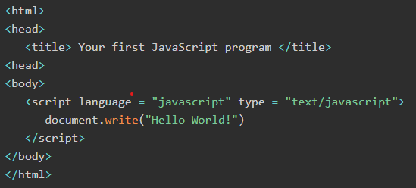
First JavaScript code on webpage
JavaScript Tutorials
Topics
Enable and disable JavaScript
Basic Syntax on webpage
First JavaScript code
Literals in JavaScript
Chapter - 2
My first code in JavaScript

Slide 16
Literal in JavaScript
JavaScript Tutorials
Topics
Enable and disable JavaScript
Basic Syntax on webpage
First JavaScript code
Literals in JavaScript
Chapter - 2
In JavaScript, literals are fixed values that are directly written into the code. They represent constant values that do not change during the execution of the program. Literals are used to assign values to variables or to represent data directly in the code.
let age = 25; // Numeric literal
let name = "John"; // String literal
let isStudent = false; // Boolean literal
let address = null; // Null literal
let colors = ["red", "blue"]; // Array literal
let user = { id: 1 }; // Object literal
let regex = /\d+/; // Regular expression literal
let message = `Hi, ${name}`; // Template literal
Literals are immutable: Once defined, their value cannot be changed.
They are not variables but rather the actual values assigned to variables.
They make code more readable and concise.

Slide 17
JavaScript Chapter – 3 (console)
Topics
Console.log()
Console.error()
Console.assert()
Console.clear()
Console.count()
Console.time()
Console.timeEnd()
Console.trace()
Console.warn()
Console.info()
Console.table()
Console.group()
Console.debug()
JavaScript Tutorials
Gautam Kumar- uidhtml.com

Slide 18
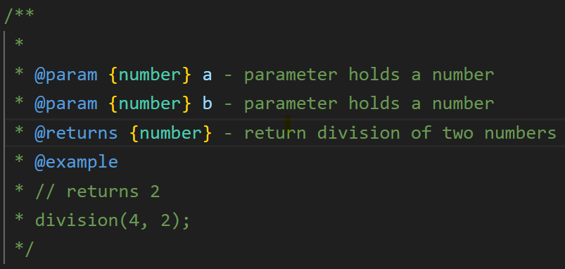
JavaScript Chapter – 4 (comments)
Topics
Single line
Inline
Multiline
JSDoc Comment
JavaScript Tutorials
Gautam Kumar- uidhtml.com

Slide 19
Comments in JavaScript
JavaScript Tutorials
Topics
Single line comments
Inline comments
Multiline comments
Chapter - 4
Single line comment // This is single-line comment to the code let x = 20;
Inline comment let x = 20; // This is inline comment
Multiline comment /* This is a multi-line comment for JavaScript code. This is very useful whenever you want to organize your JavaScript comments. */ let x = 20;

Slide 20
JavaScript Chapter – 5 (variables)
Topics
var, let and const
What is Hoisting
Hoisting with arrow function
Undefined and not-defined
Working of Call stack
JavaScript Tutorials
Gautam Kumar- uidhtml.com

Slide 21
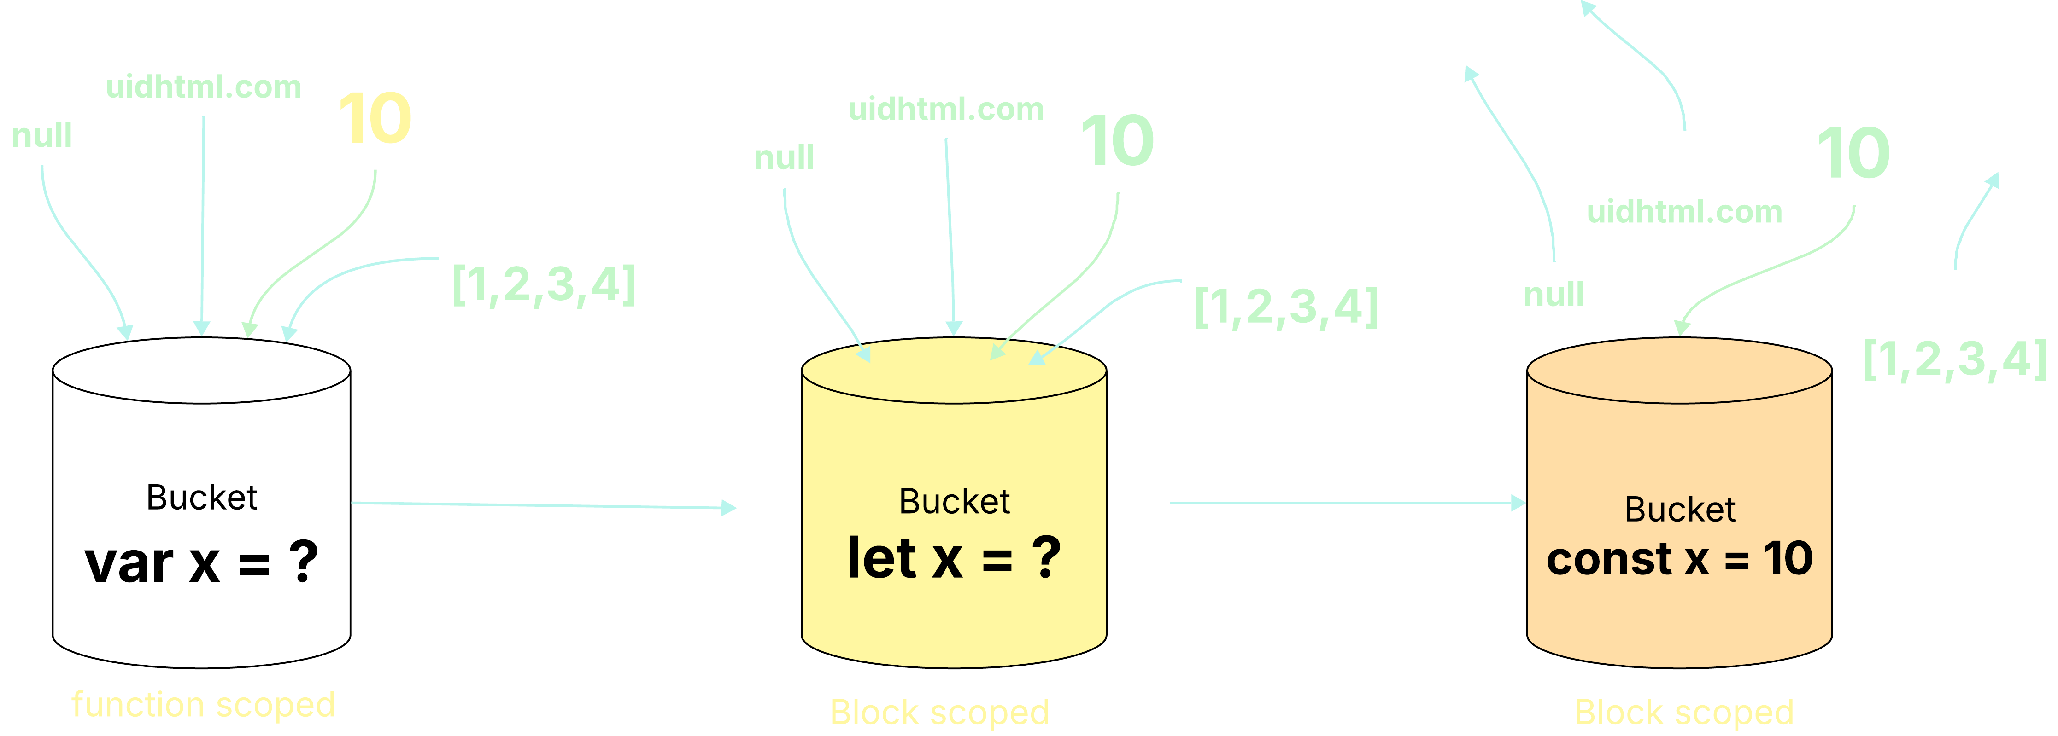
What are var, let and const?
JavaScript Tutorials
Topics
What are var, let, and const?
What is Hoisting
Undefined vs not-defined
With arrow function
What is the call stack and how it works
Chapter - 5
In JavaScript, var is a keyword used to declare variables. It was the primary way to declare variables before the introduction of let and const in ES6 (ECMAScript 2015)

Slide 22
var and let on global scope
JavaScript Tutorials
Topics
What are var, let, and const?
What is Hoisting
Chapter - 5
Global Object Property var: When declared in the global scope (outside of any function or block), var creates a property on the global object (e.g., window in browsers, global in Node.js). This means a var declared globally can be accessed as a property of the global object. let: In contrast, let declared in the global scope does not create a property on the global object. It still exists in the global scope and is accessible, but not as a direct property of window or global.

Slide 23

Re-declartion of var and let
JavaScript Tutorials
Topics
What are var, let, and const?
What is Hoisting
Chapter - 5
var: Allows re-declaration of the same variable within the same scope without an error. The later declaration simply overwrites the previous one.
let: Does not allow re-declaration of the same variable within the same scope. Attempting to do so will result in a SyntaxError.

Slide 24

What is hoisting?
JavaScript Tutorials
Topics
What are var, let, and const?
What is Hoisting
Chapter - 5
var: Variables declared with var are hoisted to the top of their scope and are initialized with undefined. This means they can be accessed before their declaration line, although their value will be undefined.
let: Variables declared with let are also hoisted, but they are not initialized. They enter a "Temporal Dead Zone" from the beginning of their scope until their declaration line. Accessing them before their declaration will result in a ReferenceError.
In summary, while both var and let can declare global variables, let offers more predictable and safer behavior by enforcing stricter rules regarding re-declaration and access before initialization, and by avoiding pollution of the global object.

Slide 25
What is hoisting? - continues
JavaScript Tutorials
Topics
What are var, let, and const?
What is Hoisting
Chapter - 5
Undefined vs not-defined
Variable with arrow function
What is the call stack and how it works

Slide 26
JavaScript Chapter – 6 (data types)
Data types Topics
Primitive data types Number String Boolean undefined null BigInt Symbols
Composite data types Object Arrays Function
JavaScript Tutorials
Gautam Kumar- uidhtml.com

Slide 27
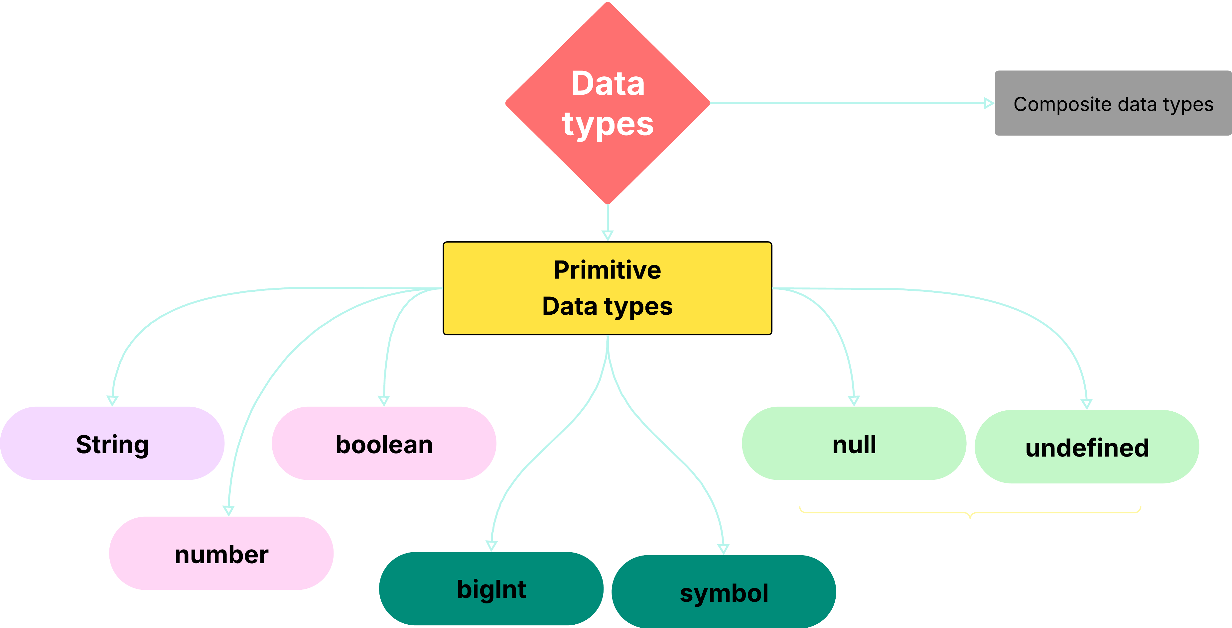
What are primitive data types?
JavaScript Tutorials
Topics
Primitive data types
Composite data types
Chapter - 6
In JavaScript, a primitive data type (or primitive value) is a piece of actual data that does not have its own properties and methods. All primitive values are immutable, meaning they cannot be altered.

Slide 28
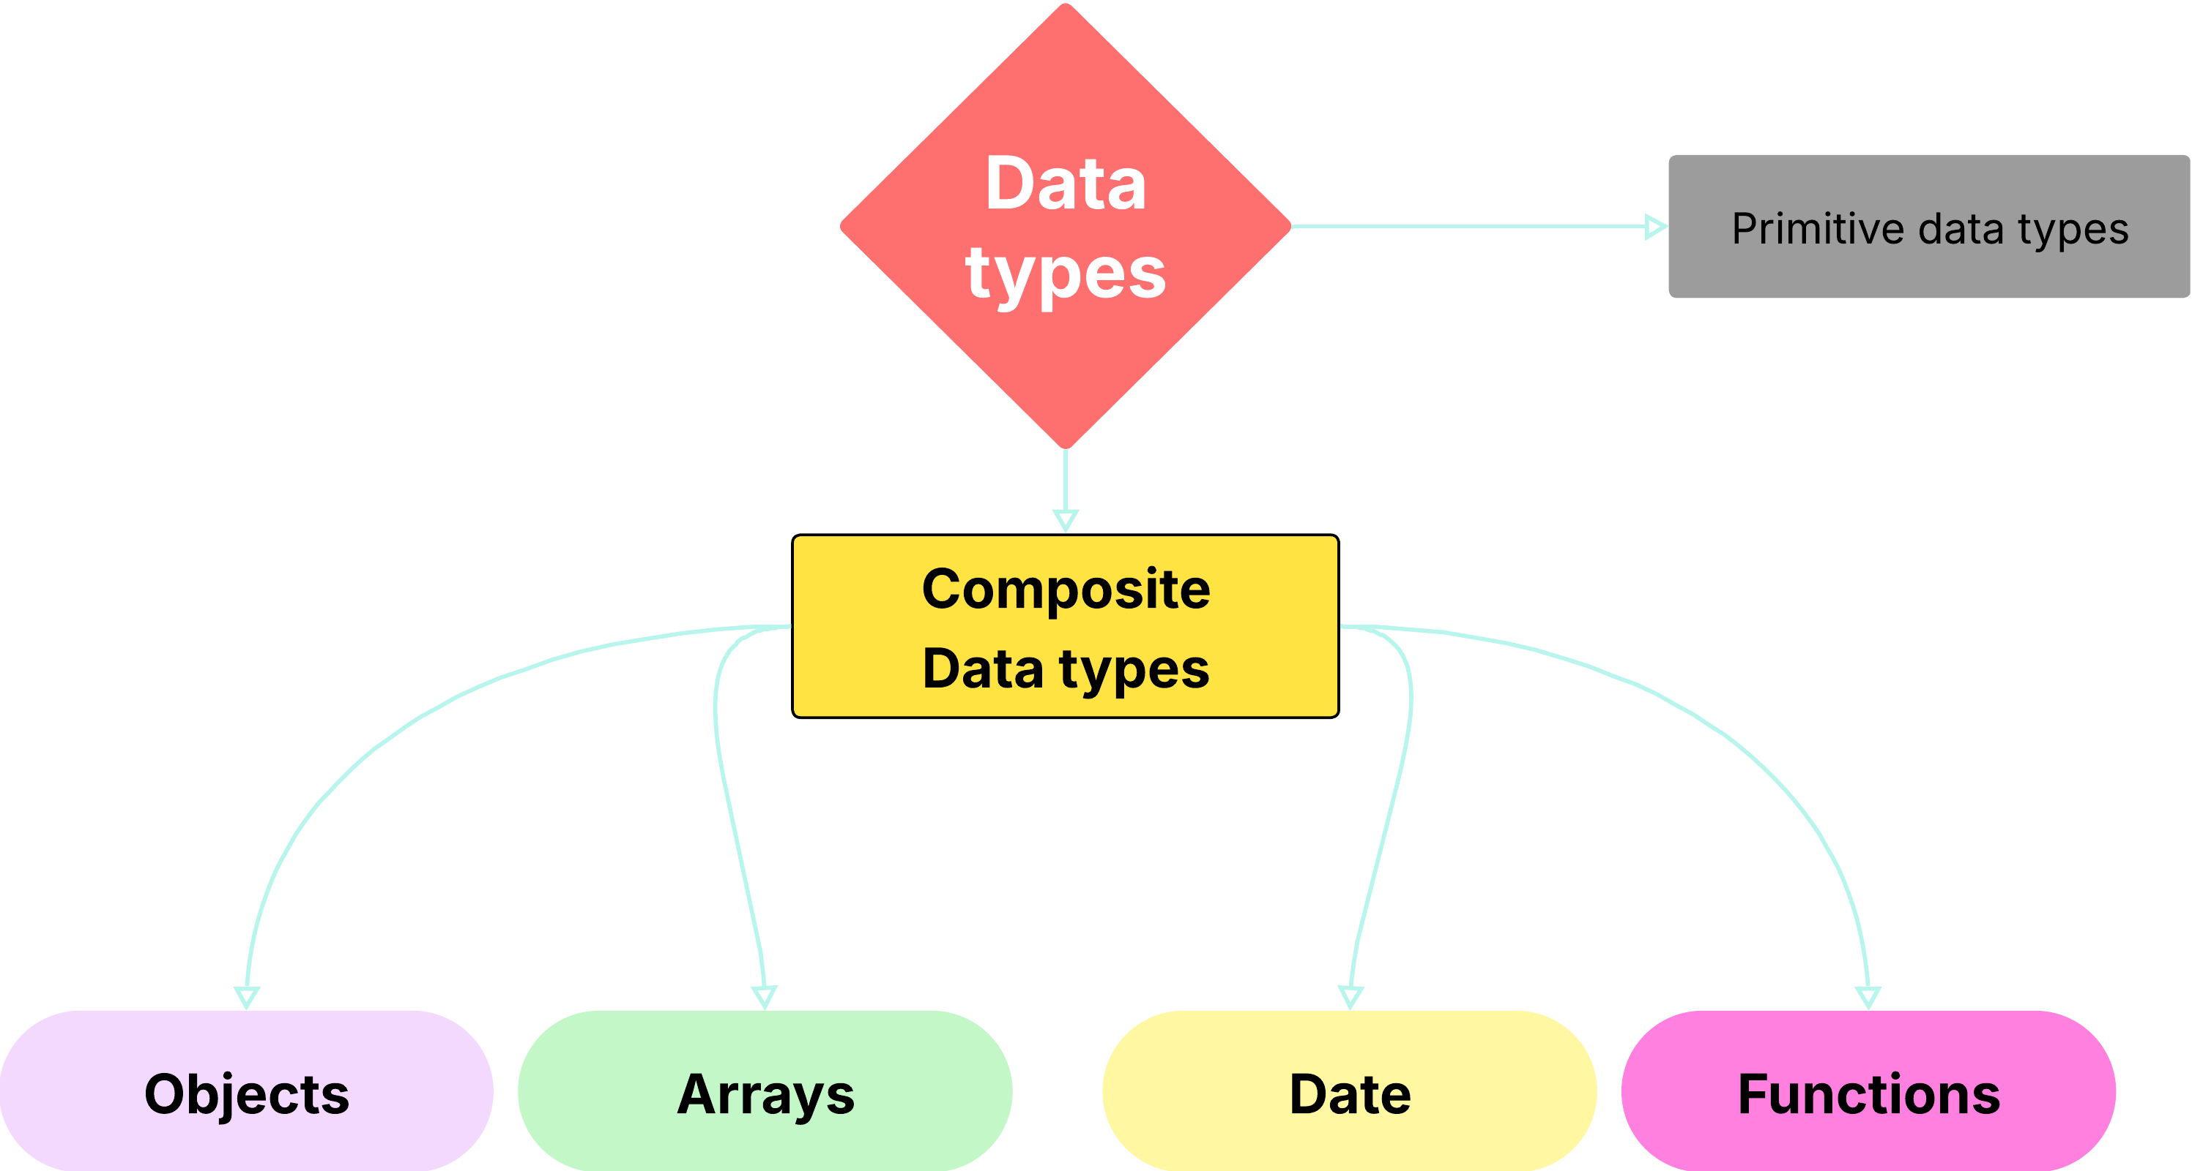
What are composite data types?
JavaScript Tutorials
Topics
Primitive data types
Composite data types
Chapter - 6
In JavaScript, composite data types, also known as non-primitive or reference types, can store collections of values and more complex entities. These types do not hold the actual value directly in the variable; instead, they store a reference to the memory location where the data is stored.

Slide 29
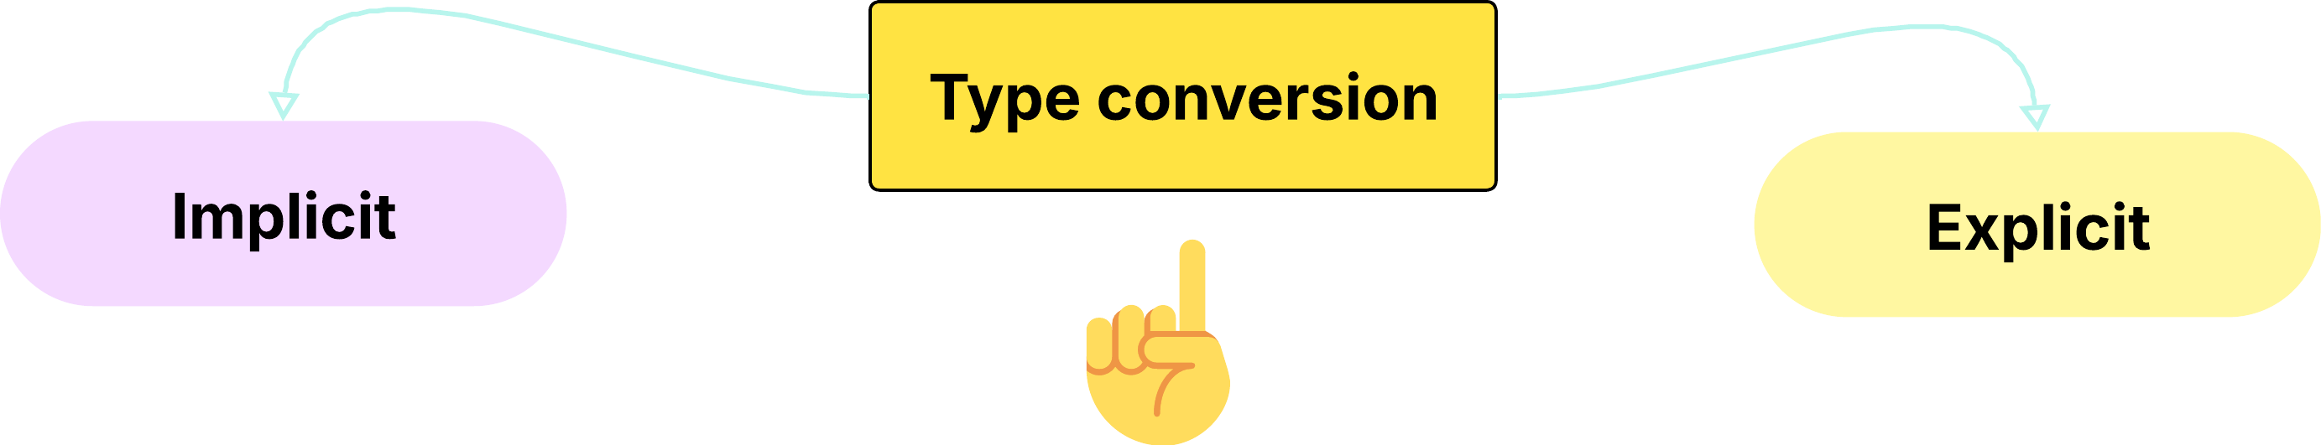
JavaScript Chapter – 7 (Type conversion)
Gautam Kumar- uidhtml.com

Slide 30
Implicit data type conversion
JavaScript Tutorials
Type conversion Topics
Implicit Conversion (Coercion)
Explicit Conversion (Casting)
Chapter - 6
When type conversion is done by JavaScript automatically, it is called implicit type conversion. For example, when we use the '+' operator with the string and number operands, JavaScript converts the number to a string and concatenates it with the string.
Explicit data type conversion
In many cases, programmers are required to convert the data type of the variable manually. It is called the explicit type conversion. String(), toString(), number(), + sign, parseInt(), parseFloat(), boolean(), !! sign

Slide 31
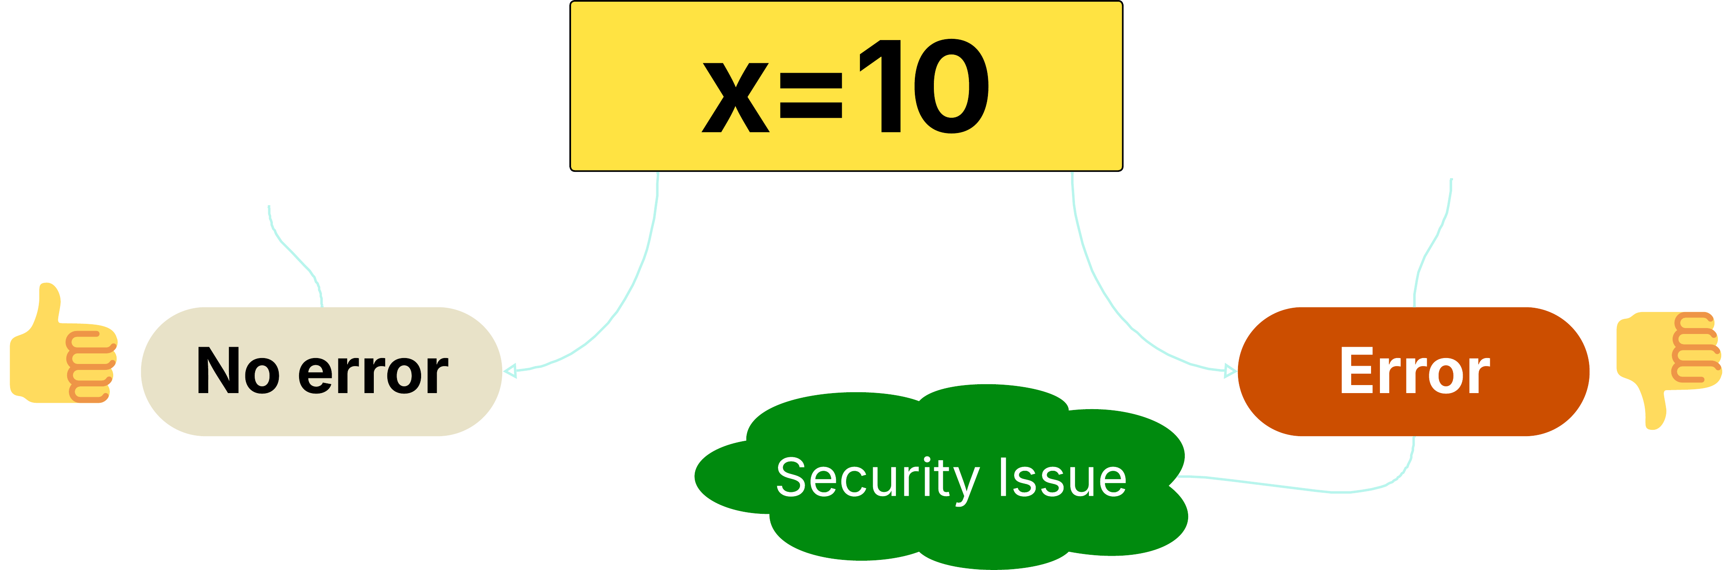

Chapter – 8 (use strict)
JavaScript
Gautam Kumar- uidhtml.com

Slide 32
Chapter – 9 (Arithmetic Operators)
JavaScript - Operators
-
/
%
+
*
Subtraction
Multiplication
++
Division
Modulus
Addition
--
Increment
Decrement
Gautam Kumar- uidhtml.com

Slide 33
Chapter – 9 (Comparison Operators)
JavaScript - Operators
!=
==
===
!==
Not Equal
Strict Equality
Equal
>=
<=
>
<
Strict Inequality
Greater than or equal to
Less than or equal to
Greater Than
Less Than
Gautam Kumar- uidhtml.com

Slide 34
Chapter – 10 More knowledge on
JavaScript - Operators
Operands?
Unary vs Binary Operators?
Notations?
Gautam Kumar- uidhtml.com

Slide 35
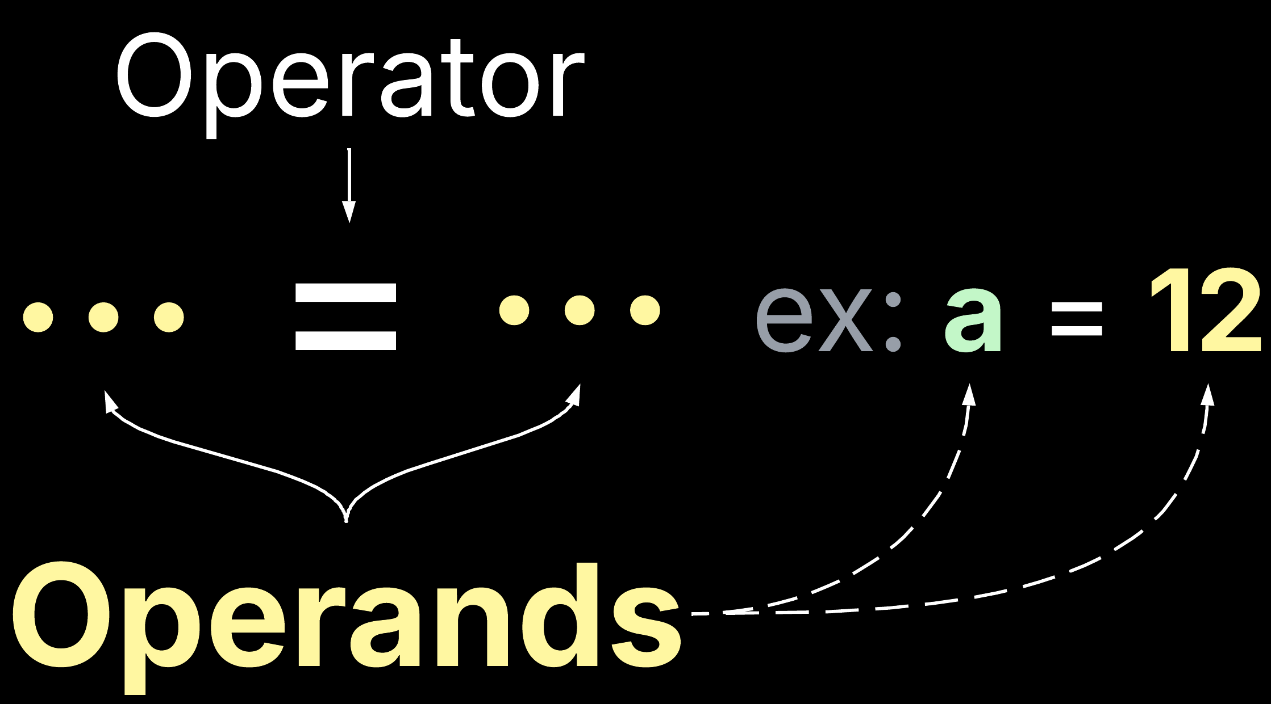
Chapter – 10 More knowledge on
JavaScript - Operators
Gautam Kumar- uidhtml.com

Slide 36

Chapter – 10 More knowledge on
JavaScript - Operators
Gautam Kumar- uidhtml.com

Slide 37
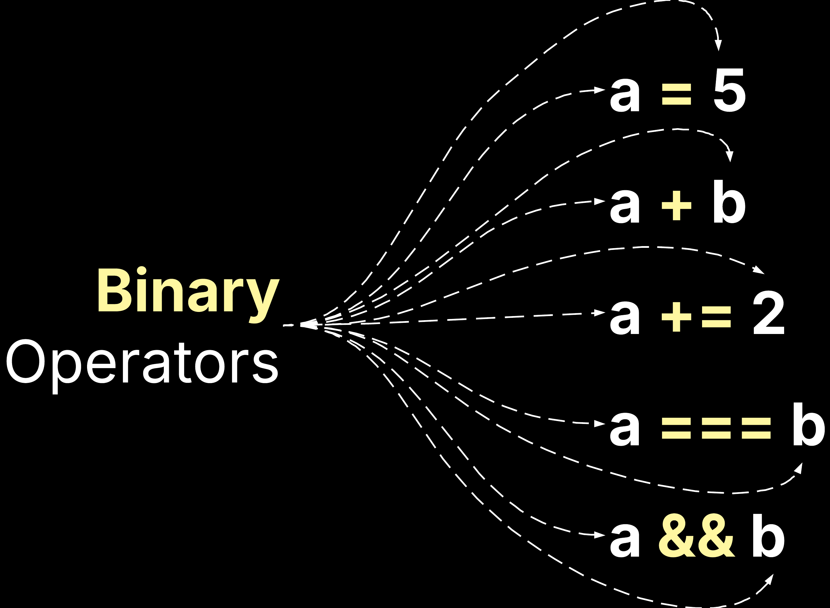
Chapter – 10 More knowledge on
JavaScript - Operators
Gautam Kumar- uidhtml.com

Slide 38

Chapter – 10 More knowledge on notations
JavaScript - Operators
Gautam Kumar- uidhtml.com

Slide 39
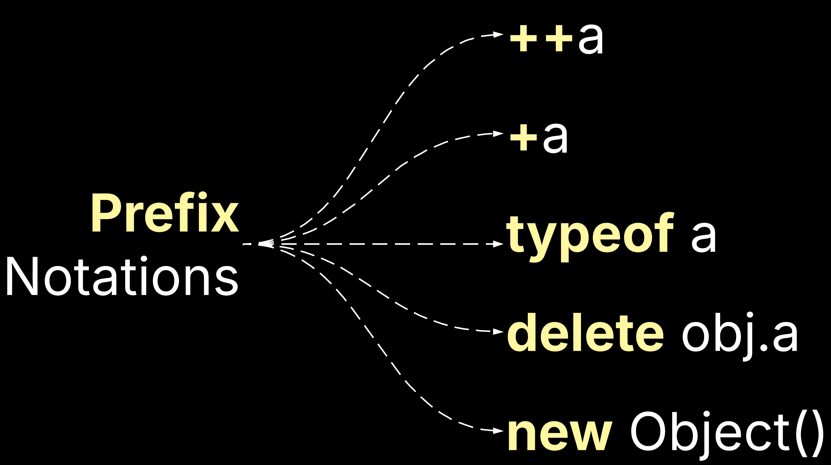
Chapter – 10 More knowledge on notations
JavaScript - Operators
Gautam Kumar- uidhtml.com

Slide 40

Chapter – 10 More knowledge on notations
JavaScript - Operators
Gautam Kumar- uidhtml.com

Slide 41
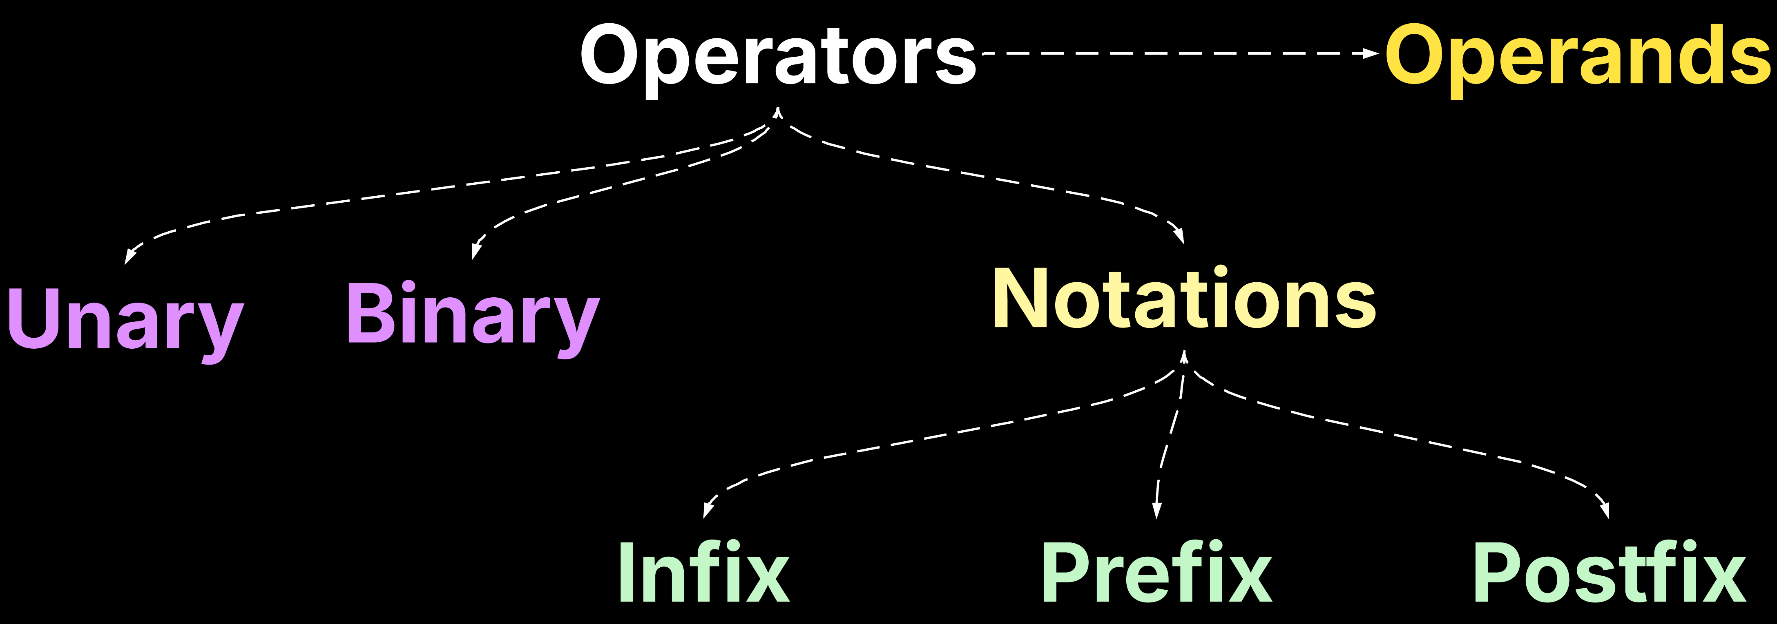
Chapter – 10
JavaScript - Operators
Gautam Kumar- uidhtml.com

Slide 42
Chapter – 11 (Logical Operators)
JavaScript - Operators
&&
||
!
Logical AND
Logical OR
Logical NOT
Gautam Kumar- uidhtml.com

Slide 43
Chapter – 12 (Conditional/Ternary Operator)
JavaScript - Operators
??
?
Nullish Operator
Conditional/Ternary
let variable = condition ? expression : expression
(Nullish Coalescing Operator)
let variable = condition ?? expression
Gautam Kumar- uidhtml.com

Slide 44
Chapter – 13 (More on Nullish Coalescing Operator)
JavaScript - Operators
??=
Gautam Kumar- uidhtml.com

Slide 45

Chapter – 14 (Exponential Operator)
JavaScript - Operators
Gautam Kumar- uidhtml.com

Slide 46
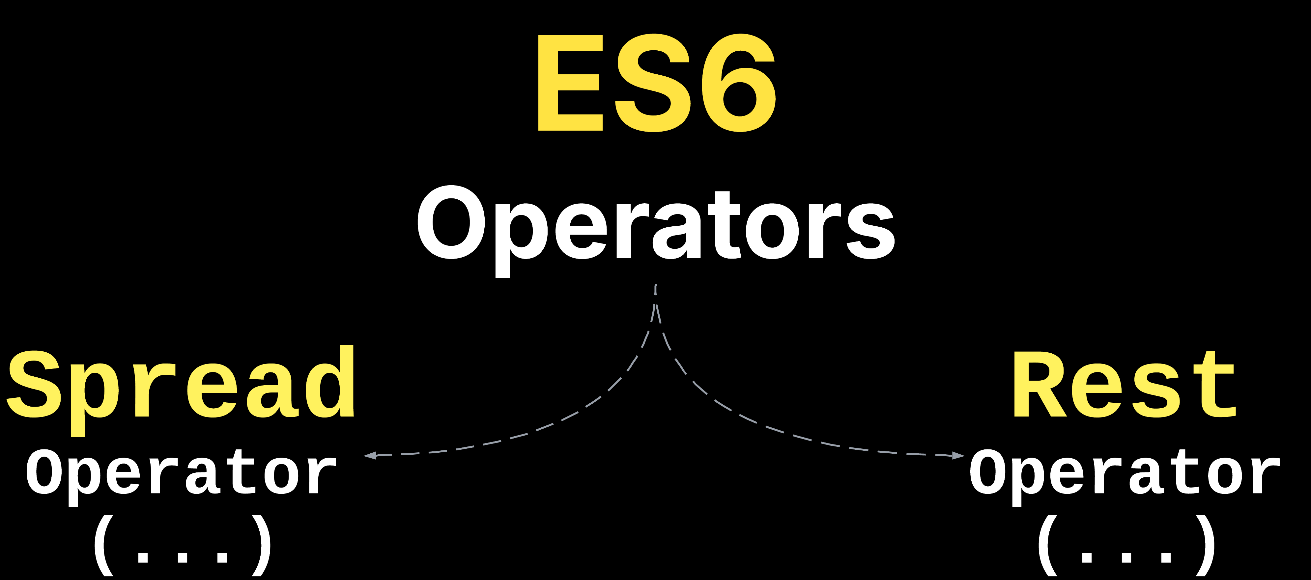
Chapter – 15
JavaScript - Operators
Gautam Kumar - uidhtml.com

Slide 47

Chapter – 16
JavaScript
ES6
Gautam Kumar- uidhtml.com

Slide 48
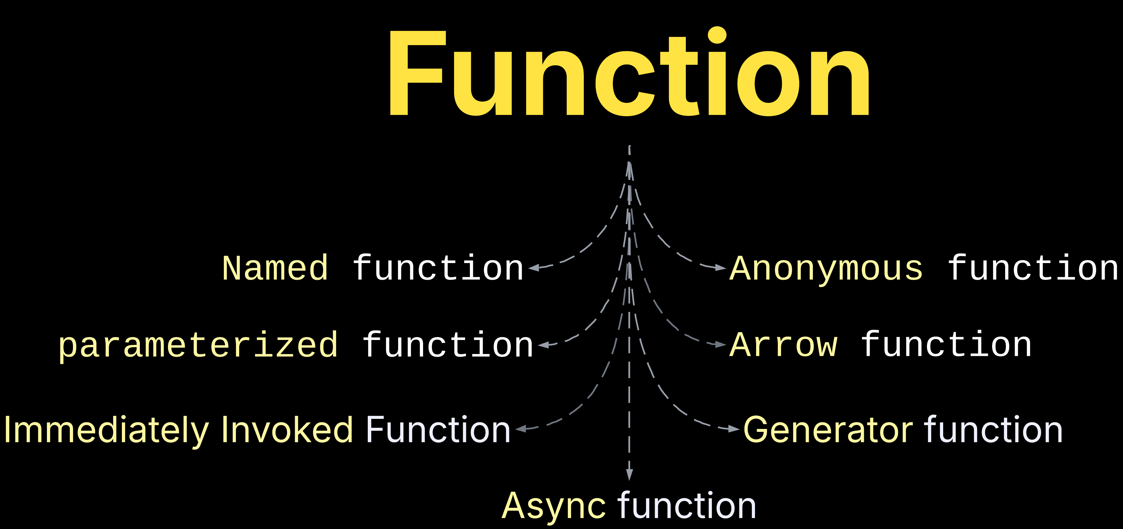
Chapter – 17
JavaScript
Gautam Kumar- uidhtml.com

Slide 49
Chapter – 17
JavaScript - function
What is function(){…}
Functions are "Code on Demand“
Variables and constants created in functions "belong" to that function
Functions CAN take parameters (arguments) and CAN return a value
Functions can be called multiple times (with different arguments)
Functions can be called "directly" and "indirectly“
Function can be stored in a variable.
Functions are objects.
Gautam Kumar- uidhtml.com

Slide 50
Chapter – 17
JavaScript - function
Difference between function() and method(){…}
Function declaration and expression.
Difference between function and method?
Gautam Kumar- uidhtml.com

Slide 51
Chapter – 17
JavaScript - function
Named function
function myFunc() {}
Gautam Kumar- uidhtml.com

Slide 52
Chapter – 17
JavaScript - function
Anonymous function
let myFunc = function () {}
Gautam Kumar- uidhtml.com

Slide 53
Chapter – 17
JavaScript - function
Parameterized function
function myFunc(a,b,c) {}
let myFunc = (a, b) => {}
Gautam Kumar- uidhtml.com

Slide 54
Chapter – 17
JavaScript - function
Immediately invoked function
(function() { …. })()
Gautam Kumar- uidhtml.com

Slide 55
Chapter – 17
JavaScript - function
Generator and Async function
async function() { return true; }
function* myFunc() { yield 1; }
Gautam Kumar- uidhtml.com

Slide 56
Chapter – 17
JavaScript - function
ES6(ECMAScript 2025) Arrow function
let myFunc = () => {}
Gautam Kumar- uidhtml.com

Slide 57
Chapter – 17
JavaScript
Function argument
function sum(...args) { return args; } let x = sum(4, 9, 16, 25, 29);
Gautam Kumar- uidhtml.com

Slide 58

Chapter – 17
JavaScript
Gautam Kumar- uidhtml.com

Slide 59
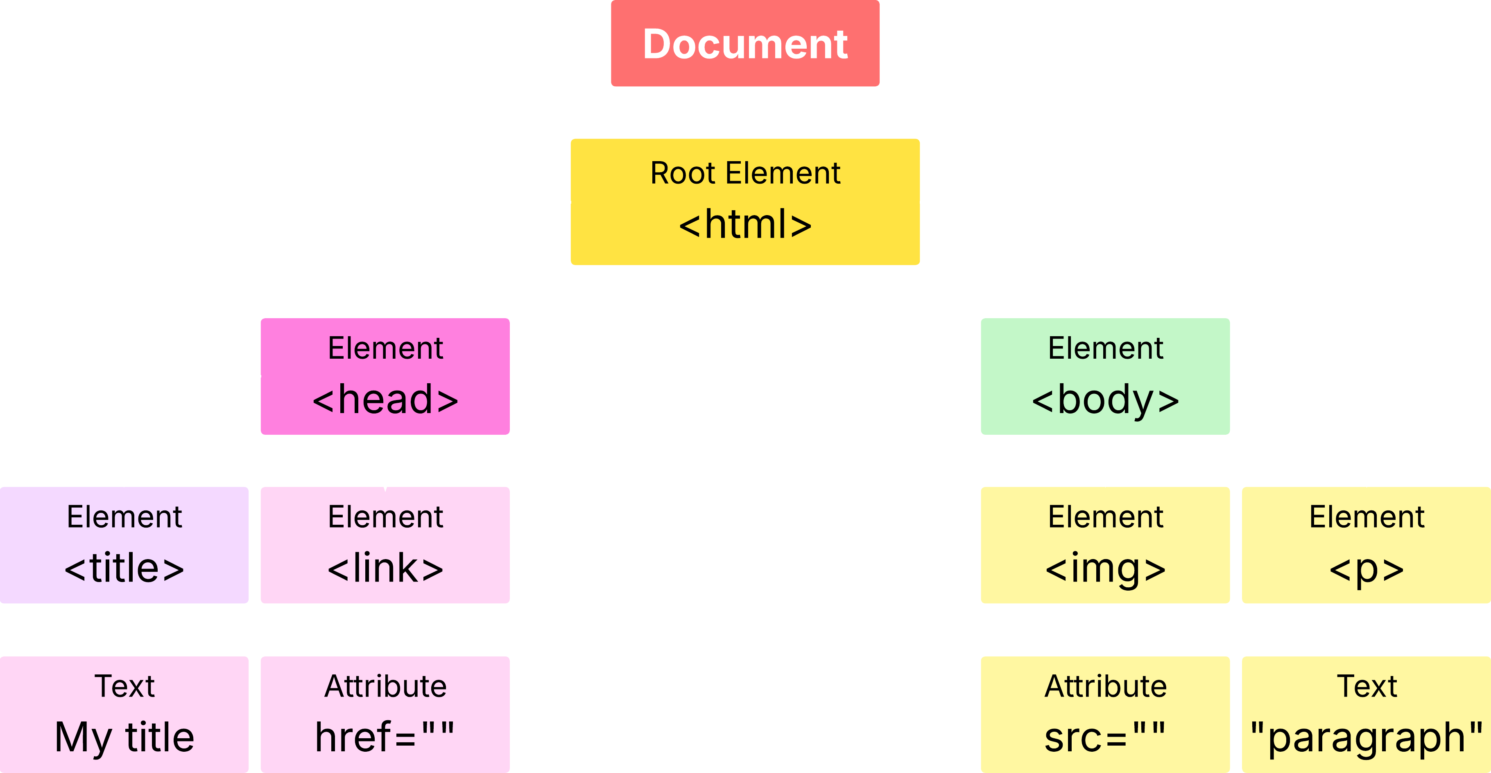
Chapter – 18
JavaScript
Gautam Kumar - uidhtml.com

Slide 60
Chapter – 18 Part -1
JavaScript- HTML DOM
Gautam Kumar - uidhtml.com
getElementById()
<div id=‘container’>Welcome to UIDHTML</div>

Slide 61
Chapter – 18 Part -2
JavaScript- HTML DOM
Gautam Kumar - uidhtml.com
getElementsByClassName()
<div class=‘wrapper’>Welcome to UIDHTML</div> <div class=‘wrapper’>- Gautam Kumar</div>

Slide 62
Chapter – 18 Part -3
JavaScript- HTML DOM
Gautam Kumar - uidhtml.com
getElementsByTagName()
querySelector()
querySelectorAll()

Slide 63
Chapter – 18 Part -4
JavaScript- HTML DOM
Gautam Kumar - uidhtml.com
getElementsByName()
<input name=“name” type=“text”> <input name=“email” type=“text”>

Slide 64
Chapter – 18 Part -4
JavaScript- HTML DOM
Gautam Kumar - uidhtml.com
querySelector()
<div>Welcome to UIDHTML</div> <div>- Gautam Kumar</div>

Slide 65
Chapter – 18 Part -5
JavaScript- HTML DOM
Gautam Kumar - uidhtml.com
querySelectorAll()
<div class=“wrapper”>Welcome to UIDHTML</div> <div class=“wrapper”>- Gautam Kumar</div>

Slide 66
Chapter – 19
JavaScript
Gautam Kumar - uidhtml.com
Array or []
A collection of different types of data inside a box

Slide 67
Chapter – 19
JavaScript - Array
Gautam Kumar - uidhtml.com
Key characteristics of JavaScript arrays:
Ordered Collection
Zero-Based Indexing
Dynamic Size
Heterogeneous Elements

Slide 68

Chapter – 19
JavaScript - Array
Gautam Kumar - uidhtml.com

Slide 69
Chapter – 19
JavaScript - Array
Gautam Kumar - uidhtml.com
How to initialize an Array?
let array = [];
let array = new Array();
let array = new Array().fill()
let array = new Array().from()

Slide 70
Chapter – 20
JavaScript- Control Flow
Gautam Kumar - uidhtml.com
Traditional loop
Repeat the same action again and again
for()
while()
do-while()
break
continue

Slide 71
Chapter – 21
JavaScript- Array
Gautam Kumar - uidhtml.com
forEach()
Iterate over an array, and on each iteration, it calls a callback function and provides an indexed element of the array.

Slide 72
Chapter – 22
JavaScript- Array
Gautam Kumar - uidhtml.com
ES6
for…of()
The MODERN Way to Loop Through JavaScript Arrays

Slide 73
Chapter – 23
JavaScript- Array
Gautam Kumar - uidhtml.com
Which JavaScript Loop is ACTUALLY Fastest? 🚀 (for, forEach, for...of)
Advantages and disadvantages

Slide 74
Chapter – 24
JavaScript- Array
Gautam Kumar - uidhtml.com
Array method .push() and .pop()
Add and remove an element at end of an array

Slide 75
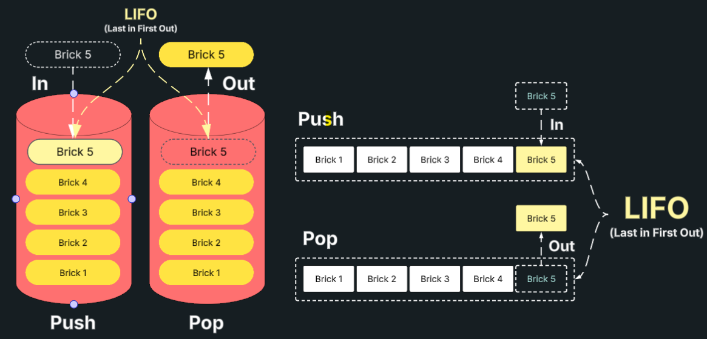
Chapter – 24
JavaScript- Array - .push() & .pop()
Gautam Kumar - uidhtml.com

Slide 76
Chapter – 25
JavaScript- Array
Gautam Kumar - uidhtml.com
Array method .shift() and .unshift()
Add and remove at the beginning of an array

Slide 77
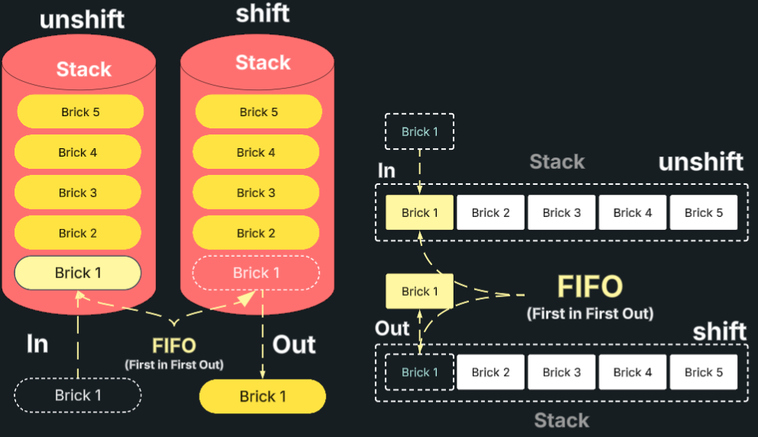
Chapter – 25
JavaScript- Array
Gautam Kumar - uidhtml.com

Slide 78
Chapter – 26
JavaScript- Array
Gautam Kumar - uidhtml.com
Array method .slice() and .splice()
Take out some portion of an an array

Slide 79
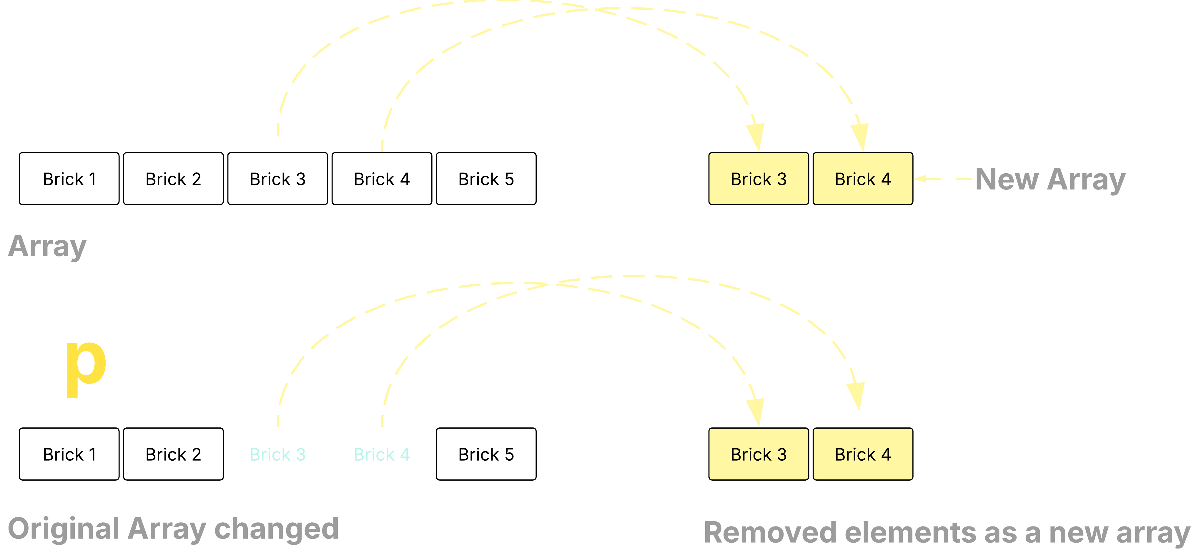
Chapter – 26
JavaScript- Array
Gautam Kumar - uidhtml.com

Slide 80
Chapter – 27
JavaScript- Array
Gautam Kumar - uidhtml.com
(ES6) Array method .of()
Returns a new array from a different type of argument

Slide 81
Chapter – 28
JavaScript- Array
Gautam Kumar - uidhtml.com
Array method .from() vs (…) spread
creates a new, shallow-copied Array instance from an array-like or iterable object.

Slide 82
Chapter – 29
JavaScript- Array
Gautam Kumar - uidhtml.com
(ES13) method .at()
Accessing an element within an array using a specified index

Slide 83
Chapter – 30
JavaScript- Array
Gautam Kumar - uidhtml.com
Array method .map()
Returns a new array after loop completion

Slide 84
Chapter – 31
JavaScript- Array
Gautam Kumar - uidhtml.com
Array method .filter()
Returns a new array based on a specific condition

Slide 85
Chapter – 32
JavaScript- Array
Gautam Kumar - uidhtml.com
Array method .filter()
Returns a new array based on a specific condition

Slide 86
Chapter – 33
JavaScript- Array
Gautam Kumar - uidhtml.com
Array method .filter()
Returns a new array based on a specific condition

Slide 87
Chapter – 29
JavaScript- Array
Gautam Kumar - uidhtml.com
(ES13) method .codePointAt() vs .charCodeAt()
Accessing an element within an array using a specified index

